Slide 1

Set-Up and Experimental Basics
Contents
Examples
Research Qs
Hypotheses
Mediation
Data
Variables
Stimuli
Conditions
Sample Size
Plan
The Crossmodality Toolkit
Shape
Size
Brightness
Color
Affect
Density
Speed
Amplitude
Pitch

Slide 2



Set-Up and Experimental Basics
Contents
Examples
Research Qs
Hypotheses
Mediation
Data
Variables
Stimuli
Conditions
Sample Size
Plan
The Crossmodality Toolkit

Slide 3


Set-Up and Experimental Basics
Contents
Examples
Research Qs
Hypotheses
Mediation
Data
Variables
Stimuli
Conditions
Sample Size
Plan
The Crossmodality Toolkit

Slide 4



Set-Up and Experimental Basics
Contents
Examples
Research Qs
Hypotheses
Mediation
Data
Variables
Stimuli
Conditions
Sample Size
Plan
The Crossmodality Toolkit

Slide 5



Set-Up and Experimental Basics
Contents
Examples
Research Qs
Hypotheses
Mediation
Data
Variables
Stimuli
Conditions
Sample Size
Plan
The Crossmodality Toolkit

Slide 6
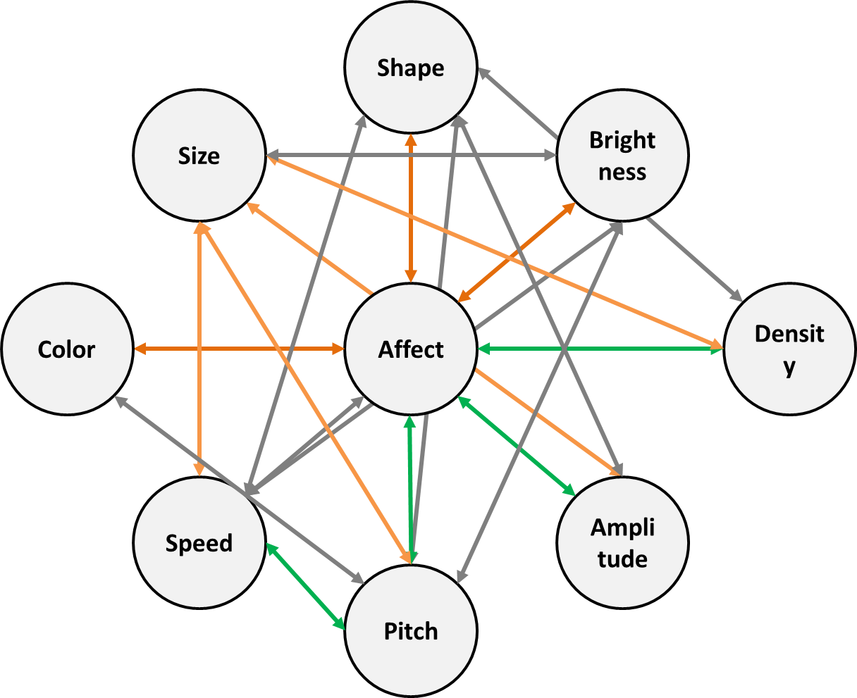
Set-Up and Experimental Basics
Contents
Examples
Research Qs
Hypotheses
Mediation
Data
Variables
Stimuli
Conditions
Sample Size
Plan
The Crossmodality Toolkit

Slide 7
Set-Up and Experimental Basics
Contents
Examples
Research Qs
Hypotheses
Mediation
Data
Variables
Stimuli
Conditions
Sample Size
Plan
Types of Preregistration
Registration prior to creation of data
Registration prior to any human observation of the data
Registration prior to accessing the data
Registration prior to analysis of the data
Registration following analysis of the data

Slide 8
Set-Up and Experimental Basics
Contents
Examples
Research Qs
Hypotheses
Mediation
Data
Variables
Stimuli
Conditions
Sample Size
Plan
Types of Preregistration
Registration prior to creation of data
Registration prior to any human observation of the data
Registration prior to accessing the data
Registration prior to analysis of the data
Registration following analysis of the data

Slide 9
Set-Up and Experimental Basics
Contents
Examples
Research Qs
Hypotheses
Mediation
Data
Variables
Stimuli
Conditions
Sample Size
Plan
Research Questions:
1- What crossmodal biases do we have?
2- How strong are they?
3- How are they related to each other?
4- What explains the large number of such biases?
5- How well do current overarching theories account for the number and strength of crossmodal biases?
6- Are crossmodal biases universal (shared by humans crossculturally/crosslinguistically)?

Slide 10
Set-Up and Experimental Basics
Contents
Examples
Research Qs
Hypotheses
Mediation
Data
Variables
Stimuli
Conditions
Sample Size
Plan
Hypotheses:
1- The majority of tested associations will be biased
2- Participants will show a clearer bias when asked to make the same judgement repeatedly (task demand)
3- Associations between emotion and other domains mediate other associations

Slide 11


Set-Up and Experimental Basics
Contents
Examples
Research Qs
Hypotheses
Mediation
Data
Variables
Stimuli
Conditions
Sample Size
Plan
Mediation:
Are all biases “real”?
=
Affect
=
Color
Pitch
=

Slide 12



Set-Up and Experimental Basics
Contents
Examples
Research Qs
Hypotheses
Mediation
Data
Variables
Stimuli
Conditions
Sample Size
Plan
Mediation:
Are all biases “real”?
=
Affect
=
Shape
Brightness
=

Slide 13
Set-Up and Experimental Basics
Contents
Examples
Research Qs
Hypotheses
Mediation
Data
Variables
Stimuli
Conditions
Sample Size
Plan
Data Collection Procedures:
Population: (nominally) U.S. Mechanical Turk Workers
Selection: Task Completion Rate, Attention Checks
Payment: $6 USD/hr

Slide 14
Set-Up and Experimental Basics
Contents
Examples
Research Qs
Hypotheses
Mediation
Data
Variables
Stimuli
Conditions
Sample Size
Plan
Variables:
Dependent Variables:
1- Response Direction
What do participants associate with what? This is a raw measure of simply how they respond on each trial
2- Response Correctness
There are a few sets of predictions that one could make about how participants will respond- which best accounts for the data?
3- Reaction Time
We are unlikely to look at this, other than perhaps as a data exclusion criteria, but we include it anyway

Slide 15
Set-Up and Experimental Basics
Contents
Examples
Research Qs
Hypotheses
Mediation
Data
Variables
Stimuli
Conditions
Sample Size
Plan
Variables:
Manipulated Variables:
1- Comparisons
Participants will see stimuli from a large number of stimulus domains (9 in main experiment, 5 additional in planned follow-up)

Slide 16
Set-Up and Experimental Basics
Contents
Examples
Research Qs
Hypotheses
Mediation
Data
Variables
Stimuli
Conditions
Sample Size
Plan
Domains:
1- Sound Domains: Pitch, Amplitude (Loudness), Noise
2- Object Domains: Shape, Size, Speed, Color, Brightness
3- “Affect” Domain

Slide 17
Set-Up and Experimental Basics
Contents
Examples
Research Qs
Hypotheses
Mediation
Data
Variables
Stimuli
Conditions
Sample Size
Plan
Sound Domains:
Four Sets of Tokens
Hum
Piano
Tone
Pulse

Slide 18
Set-Up and Experimental Basics
Contents
Examples
Research Qs
Hypotheses
Mediation
Data
Variables
Stimuli
Conditions
Sample Size
Plan
Sound Domains:
Amplitude (Loudness)-
High (Loud)
Low (Quiet)

Slide 19
Set-Up and Experimental Basics
Contents
Examples
Research Qs
Hypotheses
Mediation
Data
Variables
Stimuli
Conditions
Sample Size
Plan
Sound Domains:
Pitch-
High
Low

Slide 20
Set-Up and Experimental Basics
Contents
Examples
Research Qs
Hypotheses
Mediation
Data
Variables
Stimuli
Conditions
Sample Size
Plan
Sound Domains:
Noise-
High
Low

Slide 21








Set-Up and Experimental Basics
Contents
Examples
Research Qs
Hypotheses
Mediation
Data
Variables
Stimuli
Conditions
Sample Size
Plan
Object Domains:
Shape-
Jagged
Curvy

Slide 22








Set-Up and Experimental Basics
Contents
Examples
Research Qs
Hypotheses
Mediation
Data
Variables
Stimuli
Conditions
Sample Size
Plan
Object Domains:
Size-
Large
Small

Slide 23
Set-Up and Experimental Basics
Contents
Examples
Research Qs
Hypotheses
Mediation
Data
Variables
Stimuli
Conditions
Sample Size
Plan
Object Domains:
Speed-
Fast
Slow

Slide 24








Set-Up and Experimental Basics
Contents
Examples
Research Qs
Hypotheses
Mediation
Data
Variables
Stimuli
Conditions
Sample Size
Plan
Object Domains:
Brightness-
Bright
Dark

Slide 25






Set-Up and Experimental Basics
Contents
Examples
Research Qs
Hypotheses
Mediation
Data
Variables
Stimuli
Conditions
Sample Size
Plan
Object Domains:
Colour-
Yellow
vs.
Blue
Red
vs.
Yellow
Red
vs.
Green
Red
vs.
Blue

Slide 26






Set-Up and Experimental Basics
Contents
Examples
Research Qs
Hypotheses
Mediation
Data
Variables
Stimuli
Conditions
Sample Size
Plan
Affect Domain:
Stressed
vs.
Calm
Pleased
vs.
Disgusted
Happy
vs.
Sad
Excited
vs.
Bored

Slide 27
Set-Up and Experimental Basics
Contents
Examples
Research Qs
Hypotheses
Mediation
Data
Variables
Stimuli
Conditions
Sample Size
Plan
Variables:
Manipulated Variables:
1- Comparisons
Participants will see stimuli from a large number of stimulus domains (9 in main experiment, 5 additional in planned follow-up)
2- Conditions
Not all participants will see all comparisons

Slide 28
Set-Up and Experimental Basics
Contents
Examples
Research Qs
Hypotheses
Mediation
Data
Variables
Stimuli
Conditions
Sample Size
Plan
Conditions and Tractability:
With 9 Domains, there are 72 Comparisons to be made (ignoring token sets)
At 4 trials/comparison (a minimal number), this would be 288 trials/participant – that’s too long (~45 minutes) for an online experiment

Slide 29
Set-Up and Experimental Basics
Contents
Examples
Research Qs
Hypotheses
Mediation
Data
Variables
Stimuli
Conditions
Sample Size
Plan
Conditions and Tractability:
The solution?
Query only a sample of associations for any given subject
Each participant makes 24 comparisons based on 3 “Focal Domains”

Slide 30
Set-Up and Experimental Basics
Contents
Examples
Research Qs
Hypotheses
Mediation
Data
Variables
Stimuli
Conditions
Sample Size
Plan
Conditions and Tractability:
6 Configurations of Focal Domains (6 Conditions)
But there are lots of ways we could have done this!

Slide 31
Set-Up and Experimental Basics
Contents
Examples
Research Qs
Hypotheses
Mediation
Data
Variables
Stimuli
Conditions
Sample Size
Plan
Variables:
Data Aggregation:
Aggregated per Participant by Comparison
Control
There are no control groups

Slide 32
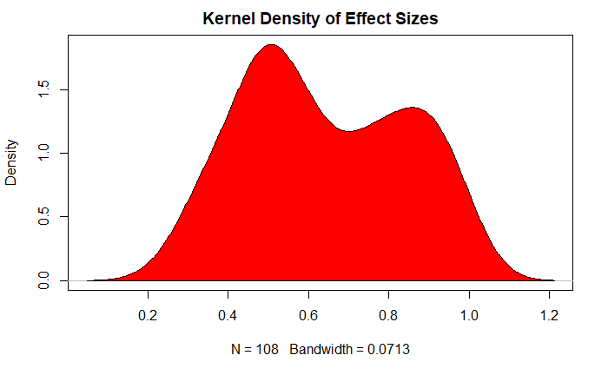
Set-Up and Experimental Basics
Contents
Examples
Research Qs
Hypotheses
Mediation
Data
Variables
Stimuli
Conditions
Sample Size
Plan
Sample Size Rationale:
Pilot Data:
Pilot data produced many significant results (108 of 186 comparisons significant).

Slide 33
Set-Up and Experimental Basics
Contents
Examples
Research Qs
Hypotheses
Mediation
Data
Variables
Stimuli
Conditions
Sample Size
Plan
Sample Size Rationale:
Pilot Data:
Effect size of lowest significant result was 0.34 with 30 participants (of 60 collected) making that comparison at least once.
Assuming we want 90% Power at an alpha level that is corrected for the large number of comparisons we will make (α = 0.00054), we should need 200 observations (400 participants)
With our corrected p-value, and 100 observations (200 participants), we have a power of ~44%

Slide 34
Set-Up and Experimental Basics
Contents
Examples
Research Qs
Hypotheses
Mediation
Data
Variables
Stimuli
Conditions
Sample Size
Plan
Sample Size Rationale:
Pilot Data:
But this is just our *lowest* effect size we are interested in- the pilot suggests that most effect sizes are far larger
The average number of participants required based on the data collected from our pilot suggests N= 83 (166 participants)
That is a number we can shoot for!

Slide 35
Set-Up and Experimental Basics
Contents
Examples
Research Qs
Hypotheses
Mediation
Data
Variables
Stimuli
Conditions
Sample Size
Plan
Data Exclusion Policy:
Pilot Data:
1- Failing attention checks
2- RTs too fast
3- Not trying (e.g. clicking same button on every trial)

Slide 36
Set-Up and Experimental Basics
Contents
Examples
Research Qs
Hypotheses
Mediation
Data
Variables
Stimuli
Conditions
Sample Size
Plan
Data Collection Plan
Phase 1- Pilot Data- Collected and Analysed
Phase 2- Affect-Centric Data- Collected, not Analysed
Phase 3- Main Experiment- Not Collected
Phase 4- “Linguistic” Experiment- Not Collected

Slide 37
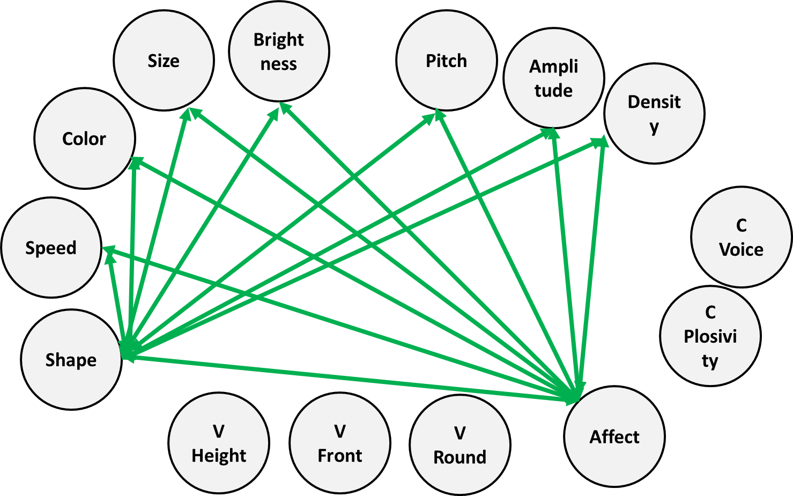
Set-Up and Experimental Basics
Contents
Examples
Research Qs
Hypotheses
Mediation
Data
Variables
Stimuli
Conditions
Sample Size
Plan
The Final Product

